Slide 1
AUTOMATED TOLL PLAZA
--project by
Nitish Bharti
Pratyush Gupta
Pranav Gupta
Vishal Som
Shubhanshu Chauhan
[B.Tech CSE, IIT(ISM) Dhanbad]

Slide 2
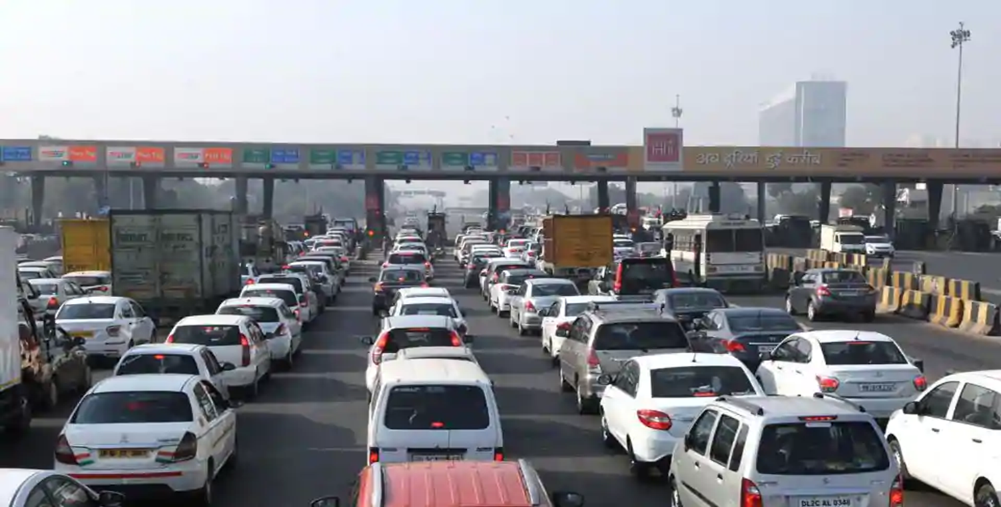
PROBLEMS FACED BY PEOPLE AND ENVIRONMENT--
People have to wait for long due to the slow manual receipt systems used on the toll booths of the highways.
Common people face large number of problems and are often late for their work owing to undesired long queues.
Availability of liquid cash and lower denominations has also been a concern on which our PM is focussing.
Emissions from the automobiles are a big concern and the environment is hit badly by the poisonous gases emitted.

Slide 3
OUR SOLUTION TO THE PROBLEM
We have worked upon designing an android application which would serve the needs of the people by allowing them to complete their payment beforehand on the app.
Total amount payable will be corresponding to the total sum of all the toll plazas which will be encountered during the course of our journey.
The payment will be made corresponding to our vehicle’s registration number before or during our journey.
When the vehicle approaches the toll booth, cameras will capture the image of the vehicle’s number plate and the gate will automatically open if the number matches with our database which contains the vehicle numbers whose payments are completed.

Slide 4
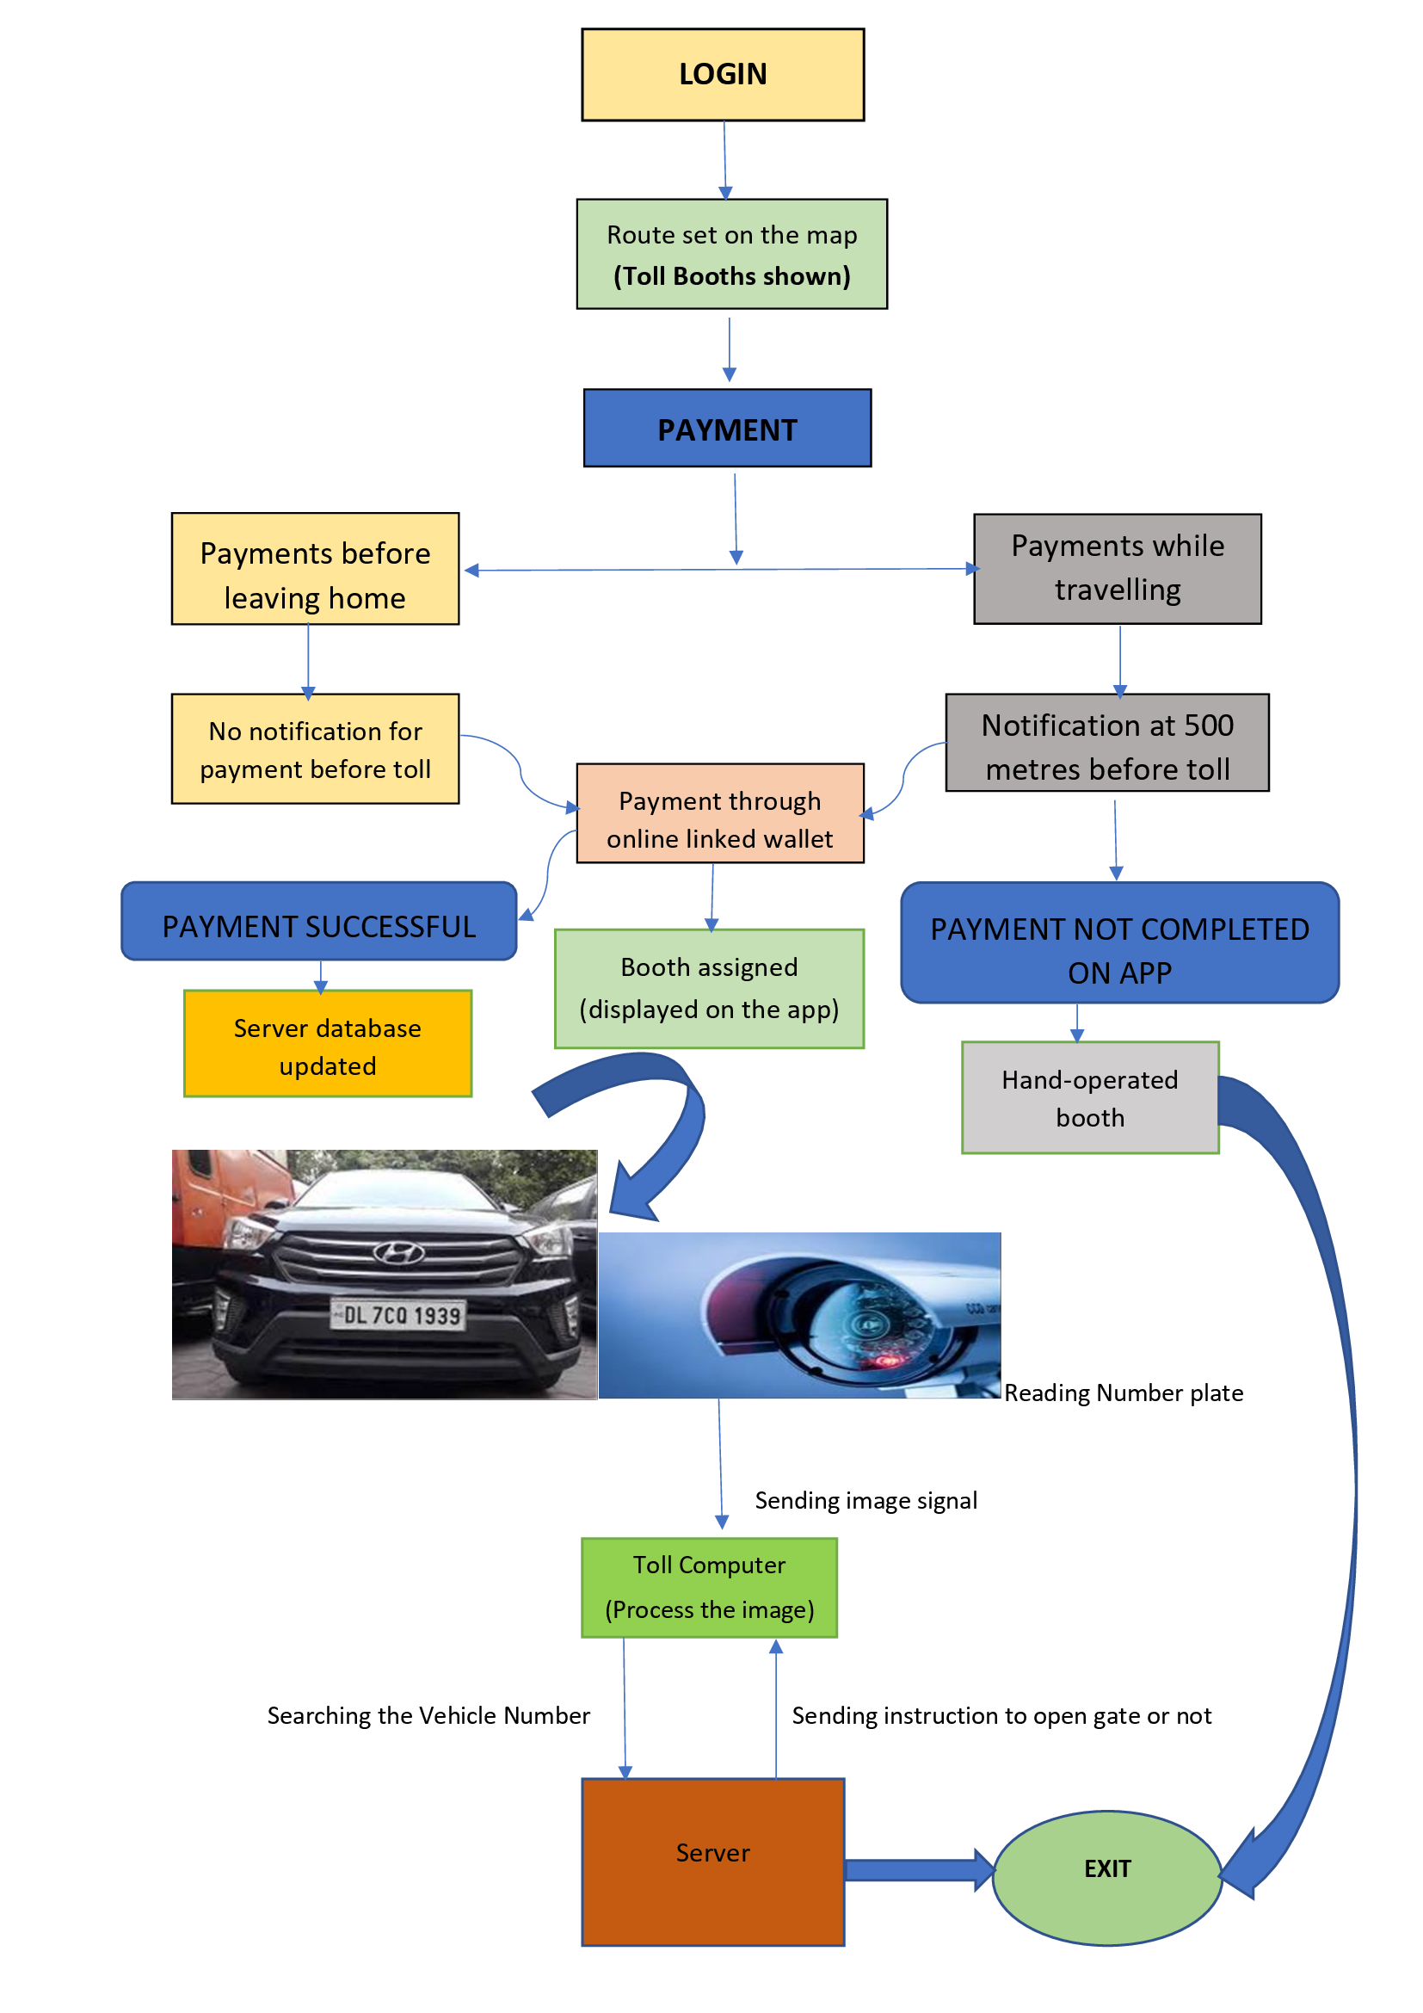

Slide 5
RECOGNIZATION OF NUMBER PLATE
We will use the CCTV cameras installed at the toll booth to scan the pictures of vehicles entering.
Our model will detect the REGISTRATION no of the car using the image processing using MATLAB.
The registration no will then go in our database and check whether the payment is completed for the vehicle .
If we get a positive response on the query, then the toll gate will allow the vehicle to move on.

Slide 6
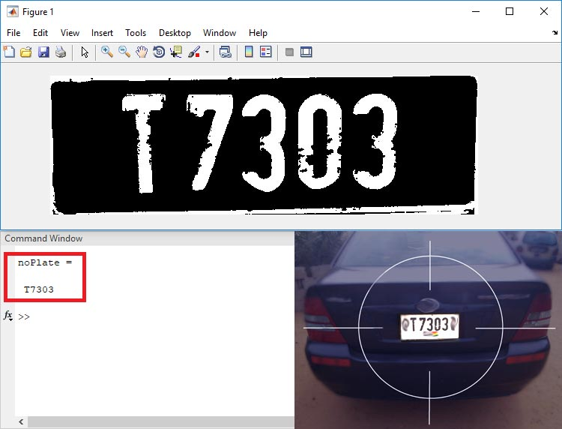
Input images
Pre processing
Character segmentation
Plate localisation
Character recognition
Output plate character as text

Slide 7
Benefits to society and environment
No human involvement in the billing process hence reducing chances of errors.
Cash which would have been lost by the government due to the corrupt employees at the booth will now go directly to the linked government account, hence end of corruption.
ZERO waiting time at toll booths.
hence, no wastage of costly time of our valuable lifes.
and, reduction in air pollution due to vehicles which would have stopped due to the slow manual billing system and pollute our mother earth with harmful gases.

Slide 8
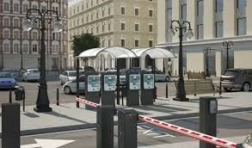
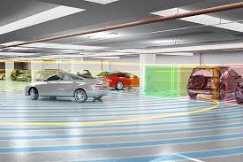
FUTURE PROSPECTIVE
Automated parking system
--app can also be implemented using our app through minute modifications.

Slide 9
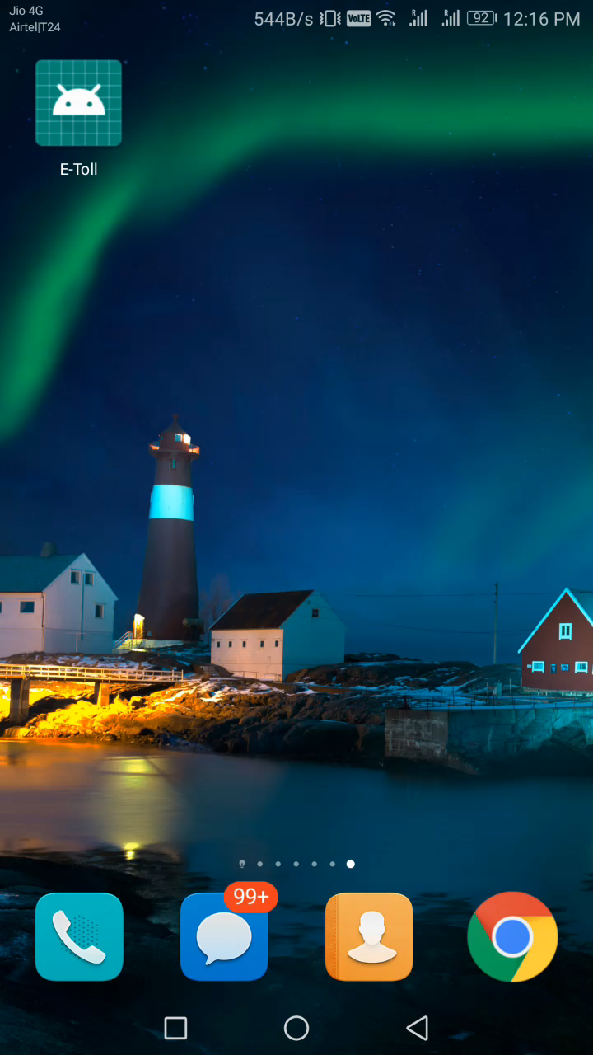

Slide 10
THANK YOU ALL --team VECTOR

